Slide 1
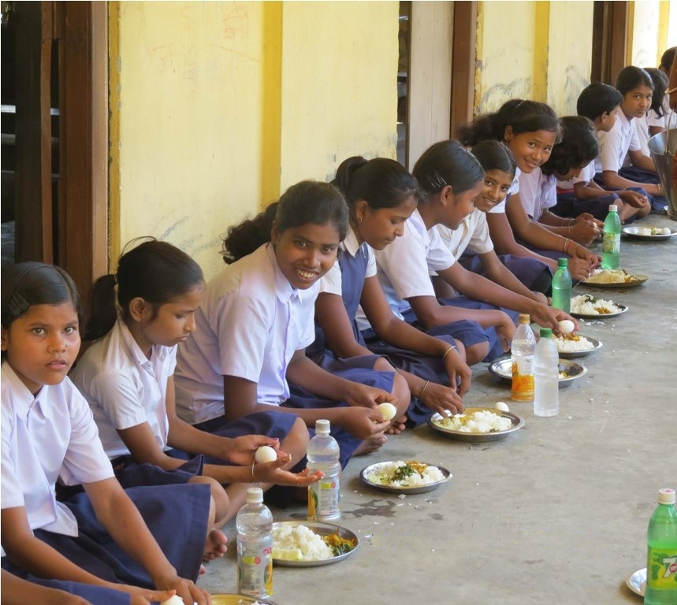
PAB - MDM Meeting for Review of Implementation of MDMS in UTs 06.05.2019
Mid Day Meal Scheme

Slide 2
No. of Schools (Primary & U. Primary)
Name of UT | PAB Approval | Coverage | %age
A&N Islands | 332 | 332 | 100%
Chandigarh | 123 | 123 | 100%
Dadra & Nagar Haveli | 280 | 280 | 100%
Daman & Diu | 96 | 94 | 98%
Delhi | 2973 | 2973 | 100%
Lakshadweep | 39 | 39 | 100%
Puducherry | 431 | 429 | 100%

Slide 3
Coverage of children (Primary & U. Primary)
UTs | Children (Pry) |  |  | Children (U.Pry)
 | PAB Approval | Coverage | %age | PAB Approval | Coverage | %age
A&N Islands | 14628 | 14017 | 96% | 10210 | 10084 | 99%
Chandigarh | 30574 | 25330 | 83% | 18739 | 16887 | 90%
Dadra & Nagar Haveli | 24280 | 22107 | 91% | 11500 | 10280 | 89%
Daman & Diu | 9400 | 8916 | 95% | 6600 | 6092 | 92%
Delhi | 612604 | 568385 | 93% | 451700 | 386314 | 86%
Lakshadweep | 4073 | 4469 | 109%* | 2738 | 2248 | 82%
Puducherry | 26231 | 25875 | 99% | 19235 | 18715 | 97%
*MDM was served to more children than PAB approval

Slide 4
Working Days (Primary & U. Primary)
%age coverage against PAB Approval
Name of UT | Working Days (Pry) |  |  | Working Days (U.Pry)
 | PAB Approval | Coverage | %age | PAB Approval | Coverage | %age
A&N Islands | 220 | 220 | 100% | 220 | 220 | 100%
Chandigarh | 248 | 237* | 96% | 248 | 237* | 96%
Dadra & Nagar Haveli | 244 | 240* | 98% | 244 | 240* | 98%
Daman & Diu | 233 | 230* | 99% | 233 | 230* | 99%
Delhi | 210 | 206 | 98% | 220 | 209 | 95%
Lakshadweep | 220 | 220 | 100% | 220 | 220 | 100%
Puducherry | 210 | 203 | 97% | 220 | 203** | 92%
* Less coverage due to local holiday
** Less coverage due to heavy rains

Slide 5
Engagement of Cook-cum-helpers (Primary & U. Primary)
Name of UT | PAB Approval | Engaged | %age
A&N Islands | 721 | 721 | 100%
Chandigarh | 825 | 806 | 98%
Dadra & Nagar Haveli | 926 | 926 | 100%
Daman & Diu | 320 | 320 | 100%
Delhi | 19036 | 18434 | 97%
Lakshadweep | 110 | 110 | 100%
Puducherry | 1031 | 1031 | 100%

Slide 6
Procurement of Kitchen devices (Primary & U. Primary)
UTs | PAB Approval | Procured | %age
A&N Islands | 353 | 353 | 100%
Chandigarh | 119 | 119 | 100%
Dadra & Nagar Haveli | 280 | 280 | 100%
Daman & Diu | 74 | 74 | 100%
Delhi | 174 | 174 | 100%
Lakshadweep | 0 | 0 | 0%
Puducherry | 636 | 636 | 100%
Lakshadweep – Procurement from UT funds

Slide 7
Construction of Kitchen-cum-stores (Primary & U. Primary)
Name of UT | PAB Approval | Constructed | %age
A&N Islands | 251 | 165 | 66%
Chandigarh | 10 | 7 | 70%
Dadra & Nagar Haveli | 50 | 50 | 100%
Daman & Diu | 32 | 32 | 100%
Delhi | 0 | 0 | 0%
Lakshadweep | 0 | 0 | 0%
Puducherry | 105 | 92 | 88%
Delhi – Meal served by Centralized Kitchen
Lakshadweep – Constructed from UT funds

Slide 8
Performance Grade Index (PGI)
Performance Grading Index (PGI):
Score of UTs against the weightage of 10 for indicator No. 1.3.7 i.e. “% of elementary school’s children taking MDM against target approved in PAB – in Govt. and aided schools”.
Score of UTs against the weightage of 10 for indicator No 1.3.8 i.e. “% of days Mid Day Meal served against total working days – Govt. and aided elementary schools.”
Name of UT | Score (children taking MDM) (1.3.7) out of 10 | Score (MDM served days ) (1.3.8) out of 10
A&N Islands | 10 | 10
Chandigarh | 9* | 10
Daman & Diu | 10 | 10
Dadra & Nagar Haveli | 10 | 10
Delhi | 9** | 10
Lakshadweep | 10 | 10
Puducherry | 10 | 10
* Reason: 1) Children belong to affluent families.
2) Centralized kitchens.
**Children of Govt. aided schools prefer to bring tiffins from home

Slide 9
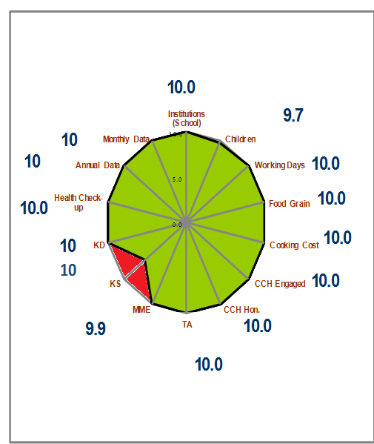
Performance Score Card – Andaman & Nicobar Islands
Component | PAB-Approval (Target) | Achievement | % Achievement
Institutions (School) | 332 | 332 | 100%
Children | 24838 | 24101 | 97%
Working Days | 220 | 220 | 100%
Food Grain Utilisation | 626.29 | 626.29 | 100%
Cooking Cost (Rs. in Lacs) | 614.05 | 614.05 | 100%
CCH Engaged | 721 | 721 | 100%
CCH Honorarium (Rs. in Lacs) | 72.10 | 72.10 | 100%
TA (Rs. in Lacs) | 4.92 | 4.92 | 100%
MME (Rs. in Lacs) | 6.87 | 6.83 | 99%
Kitchen cum Store (KS) | 251 | 165 | 66%
Kitchen Devices (KD) | 353 | 353 | 100%
No. of Children's Health Check-up | 32337 | 32337 | 100%
Annual Data Entry | 332 | 332 | 100%
Monthly Data Entry | 332 | 332 | 100%
Ministry of HRD, Govt. of India

Slide 10
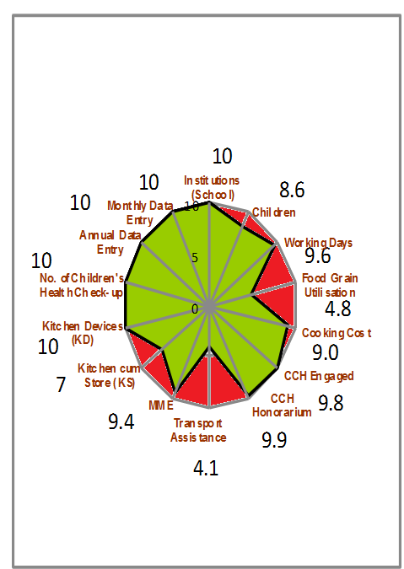
Performance Score Card – Chandigarh
Component | PAB-Approval (Target) | Achievement | % Achievement
Institutions | 123 | 123 | 100%
Children | 49313 | 42217 | 86%
Working Days | 248 | 237 | 96%
FG Utilization | 1455.32 | 696.18 | 48%
Cooking Cost (Rs. In Lakh) | 1078.14 | 967.44 | 90%
CCH Engaged | 825 | 806 | 98%
CCH Honorarium (Rs. in Lacs) | 243.7 | 241.8 | 99%
TA (Rs. in Lacs) | 10.92 | 4.46 | 41%
MME (Rs. in Lacs) | 30 | 28.27 | 94%
KS | 10 | 7 | 70%
KD | 119 | 119 | 100%
SHP | 95334 | 95334 | 100%
Annual Data Entry | 123 | 123 | 100%
Monthly Data Entry | 123 | 123 | 100%

Slide 11
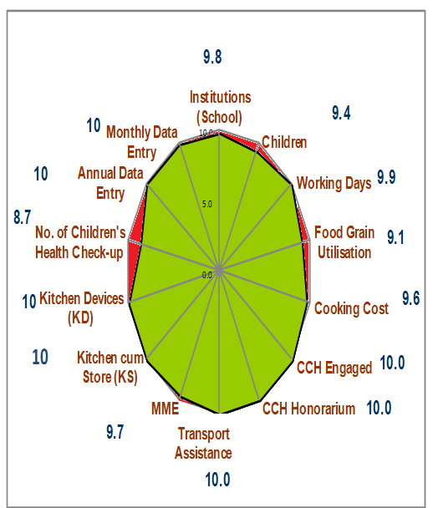
Performance Score Card – Daman & Diu
Component | PAB-Approval (Target) | Achievement | % Achievement
Institutions (School) | 96 | 94 | 98%
Children | 16000 | 15008 | 94%
Working Days | 233 | 230 | 99%
Food Grain Utilisation | 449.69 | 408.43 | 91%
Cooking Cost (Rs. in Lacs) | 469.79 | 451.87 | 96%
CCH Engaged | 320 | 320 | 100%
CCH Honorarium (Rs. in Lacs) | 109.98 | 109.98 | 100%
TA (Rs. in Lacs) | 3.38 | 3.37 | 100%
MME (Rs. in Lacs) | 60.00 | 57.95 | 97%
Kitchen cum Store (KS) | 32 | 32 | 100%
Kitchen Devices (KD) | 94 | 94 | 100%
No. of Children's Health Check-up | 18827 | 16372 | 87%
Annual Data Entry | 94 | 94 | 100%
Monthly Data Entry | 94 | 94 | 100%
Ministry of HRD, Govt. of India

Slide 12
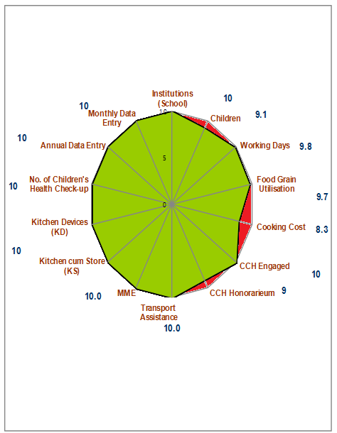
Performance Score Card – Dadra & Nagar Haveli
Component | PAB-Approval (Target) | Achievement | % Achievement
Institutions (School) | 280 | 280 | 100%
Children | 35780 | 32387 | 91%
Working Days | 244 | 240 | 98%
Food Grain Utilisation | 870.00 | 843.99 | 97%
Cooking Cost (Rs. in Lacs) | 940.38 | 780.51 | 83%
CCH Engaged | 926 | 926 | 100%
CCH Honorarium (Rs. in Lacs) | 342.60 | 306.69 | 90%
TA (Rs. in Lacs) | 7.60 | 7.60 | 100%
MME (Rs. in Lacs) | 30.00 | 30.00 | 100%
Kitchen cum Store (KS) | 50 | 50 | 100%
Kitchen Devices (KD) | 283 | 283 | 100%
No. of Children's Health Check-up | 42867 | 42867 | 100%
Annual Data Entry | 280 | 280 | 100%
Monthly Data Entry | 280 | 280 | 100%
Ministry of HRD, Govt. of India

Slide 13
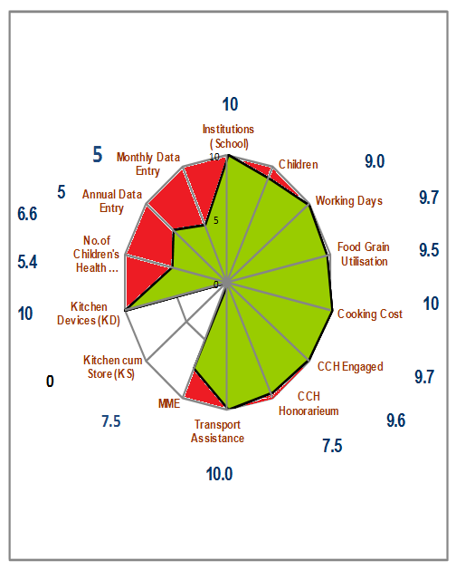
Performance Score Card - Delhi
Component | PAB-Approval (Target) | Achievement | % Achievement
Institutions (School) | 2975 | 2975 | 100%
Children | 1064304 | 954699 | 90%
Working Days | 215 | 208 | 97%
Food Grain Utilisation | 24800.82 | 23540.45 | 95%
Cooking Cost (Rs. in Lacs) | 11454.43 | 12002.33 | 105%
CCH Engaged | 19036 | 18434 | 97%
CCH Honorarium (Rs. in Lacs) | 1903.60 | 1822.79 | 96%
Transport Assistance (Rs. in Lacs) | 208.29 | 254.29 | 122%
MME (Rs. in Lacs) | 160.59 | 119.73 | 75%
Kitchen cum Store (KS) | o | o | 0%
Kitchen Devices (KD) | 174 | 174 | 100%
No. of Children's Health Check-up | 1626379 | 877544 | 54%
Annual Data Entry | 2970 | 1950 | 66%
Monthly Data Entry | 2970 | 1490 | 50%
Ministry of HRD, Govt. of India

Slide 14
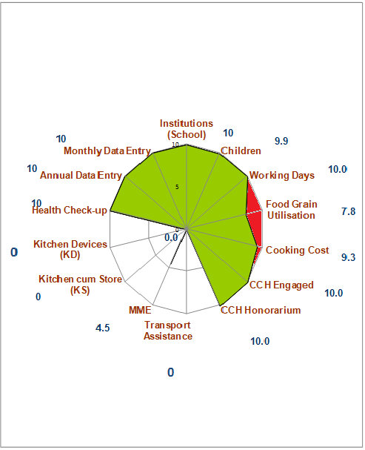
Performance Score Card - Lakshadweep
Component | PAB-Approval (Target) | Achievement | % Achievement
Institutions (School) | 39 | 39 | 100%
Children | 6811 | 6717 | 99%
Working Days | 220 | 220 | 100%
Food Grain Utilisation | 179.86 | 140.23 | 78%
Cooking Cost (Rs. in Lacs) | 237.84 | 220.19 | 93%
CCH Engaged | 110 | 110 | 100%
CCH Honorarium (Rs. in Lacs) | 103.30 | 103.30 | 100%
TA (Rs. in Lacs) | 11.09 | 0.00 | 0%
MME (Rs. in Lacs) | 30.00 | 13.36 | 45%
Kitchen cum Store (KS) | 0 | 0 | 0
Kitchen Devices (KD) | 0 | 0 | 0
No. of Children's Health Check-up | 6957 | 5231 | 75%
Annual Data Entry | 39 | 39 | 100%
Monthly Data Entry | 39 | 39 | 100%
Ministry of HRD, Govt. of India

Slide 15
Performance Score Card - Puducherry
Component | PAB-Approval (Target) | Achievement | % Achievement
Institutions (School) | 431 | 429 | 100%
Children | 45466 | 44560 | 98%
Working Days | 215 | 203 | 94%
Food Grain Utilisation | 1186.00 | 1095.00 | 92%
Cooking Cost (Rs. in Lacs) | 972.00 | 901.00 | 93%
CCH Engaged | 1031 | 1031 | 100%
CCH Honorarium (Rs. in Lacs) | 601.00 | 601.00 | 100%
Transport Assistance (Rs. in Lacs) | 8.90 | 8.60 | 97%
MME (Rs. in Lacs) | 120.00 | 5.50 | 5%
Kitchen cum Store (KS) | 105 | 92 | 88%
Kitchen Devices (KD) | 636 | 636 | 100%
No. of Children's Health Check-up | 56516 | 56516 | 100%
Annual Data Entry | 429 | 429 | 100%
Monthly Data Entry | 429 | 429 | 100%
Ministry of HRD, Govt. of India

Slide 16
Focus of this year

Slide 17
Focus of this year

Slide 18
Focus of this year
Usage of Jails, Temples, Gurudwaras etc. for Mid Day Meal:
Temples, Gurudwaras, Jails etc. can be involved in Mid Day Meal Scheme.
Temples, Gurudwaras have greater reach among community, this can help in wider publicity for Mid Day Meal Scheme.
Temples, Gurudwaras can adopt some schools for providing meals.
Enhanced sense of ownership of the Mid Day Meal Scheme among the local community.
Uploading of videos, testimonials on Shagun web-portal:
Shagun web-portal is an innovation for repository of best practices which collates videos, testimonials, case studies and images of state-level innovations and success stories.
Accordingly, relevant videos, testimonials of the innovative activities being carried out by States/UTs related to Mid Day Meal may be shared with this department so that the same may be uploaded on Shagun (https://repository.ssashagun.nic.in) repository after necessary approvals.

Slide 19
Tithi Bhojan
Tithi Bhojan, is a community participation programme initiated by Gujarat.
Community provides full meal or additional items on special occasions, birthdays, marriages, anniversaries, days of national importance and other festivals etc.
Ministry of Human Resource Development has issued Guidelines on Tithi Bhojan on 26th October, 2018 to all the States and UTs.
Tithi Bhojan has been adopted by the States & UTs of Assam (Sampriti Bhojan), Andhra Pradesh, Punjab (Priti bhojan), Dadra & Nagar Haveli (Tithi Bhojan), Daman & Diu (Tithi Bhojan), Karnataka (Shalegagi Naavu Neevu), Madhya Pradesh, Maharastra (Sneh Bhojan), Chandigarh (Tithi Bhojan), Puducherry (Anna Dhanam), Haryana (Beti ka Janamdin) and Uttarakhand (Vishesh Bhojan).

Slide 20
Automated Monitoring System
1
AMS is used to monitor MDMS on real time basis.
2
Schools need to share the daily data on number of meals and reasons if meals are not served.
3
States/UTs are using various technologies (SMS/ IVRS/ Mobile App) for daily data collection.
Graphical dashboard: Reports are generated and displayed online
4
5
Drill down reports from State to school level are available
6
Daily email alerts are sent to States and UTs level regarding implementation of AMS.
20

Slide 21
Status of implementation of MIS & AMS

Slide 22
Amendment for involvement of Centralized Kitchens only in urban areas.
Amendment of the Gazette of India notification dated 18th April, 2019 stated that:
In the MDM Rules 2015, in rule 5 for sub-rule (2) the following sub-rule shall be substituted
“(2) Every school shall have the facility for cooking meal in hygienic manner. Schools in urban areas may use the facility of centralized kitchens for cooking meals wherever required in accordance with the guidelines issued by the Central Government and the meal shall be served to the children at respected school only”

Slide 23
Status of flow of funds from State to school
Name of UT | Delay in release of fund from State to District / School
A & N Islands | 1 to 2 months
Chandigarh | 1 month
Daman & Diu | 2 months
Dadra & Nagar Haveli | 2 months
Delhi | 2 months
Lakshadweep | Timely
Puducherry | Timely

Slide 24
Focus of this year

Slide 25
Social Audit- Mid Day Meal Scheme
“Social audit" means the process in which people collectively monitor and evaluate the planning and implementation of a programme or scheme.
Importance:
Helps to ensure accountability and participation of all the stakeholders in the implementation of Mid Day Meal Scheme
It creates a sense of ownership and increases the reach of the scheme up to the beneficiaries.
Social audit enables the State Governments to identify and resolve gaps in the implementation of Mid Day meal Scheme.
Status :
Social Audit carried out in Uttarakhand and Tripura in 2018-19.
Social intervention for Community Participation under MDMS

Slide 26
Recommendation for UTs
S. No | Name of UT | PAB Approval for FY 2018-19 (Rs. in Lakhs) | Proposal for FY 2019-20 (Rs. in Lakhs) | Recommendation for FY - 2019-20* (Rs. in Lakhs)
1 | Andaman & Nicobar | 375.17 | 401.41 | 401.41
2 | Chandigarh | 761.61 | 737.35 | 727.45
3 | Daman & Diu | 304.07 | 293.95 | 283.23
4 | Dadra & Nagar Haveli | 615.28 | 606.39 | 589.33
5 | Delhi | 9143.53 | 13933.55 | 10613.56
6 | Lakshadweep | 121.99 | 125.44 | 98.60
7 | Puducherry | 519.93 | 540.59 | 422.92
*Quantifications as per revised MME norms
Ministry of HRD, Govt. of India

Slide 27
Thank you

